Slide 1

Computer Organization and Assembly Language (CS2523)
Branching
Chapter 3 of
Assembly language for x88 processors, Belal Hashmi
Department of Computer Science,
Capital University of Science and Technology, Islamabad
Fall Semester, 2022

Slide 2
Lecture Outlines
Comparison and Conditions
Conditional Jumps
Unconditional Jump
Relative Addressing
Types of Jump
Sorting Example

Slide 3
Conditional Jumps in Assembly
Branching
Types of jumps i.e. Conditional & Uncoditional
cmp, sub, inc, and decrement instructions…

Slide 4
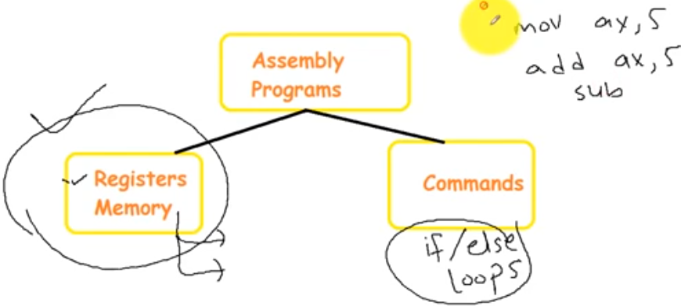

Slide 5
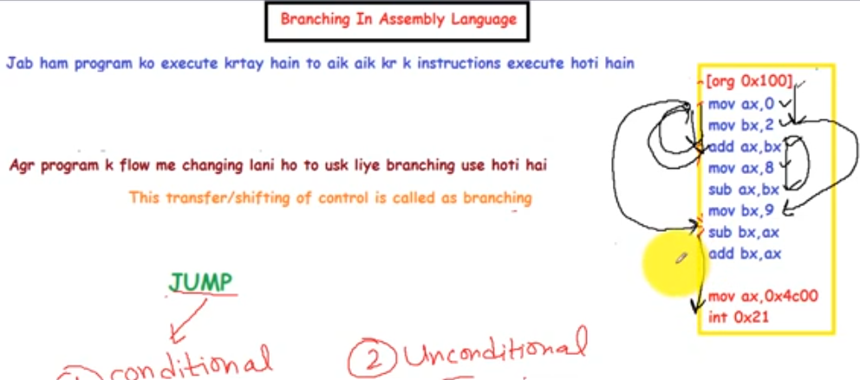

Slide 6
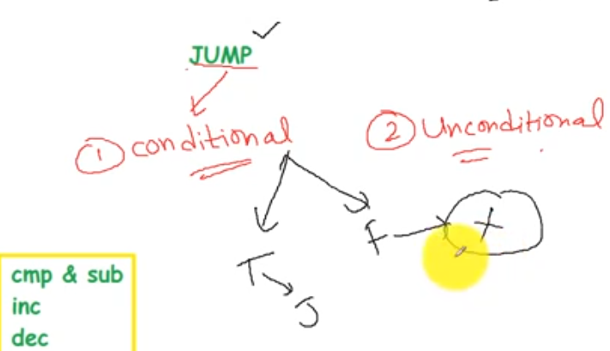

Slide 7
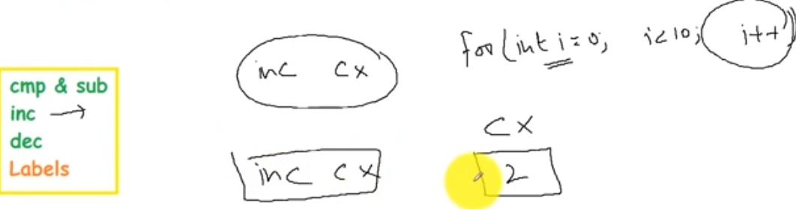

Slide 8
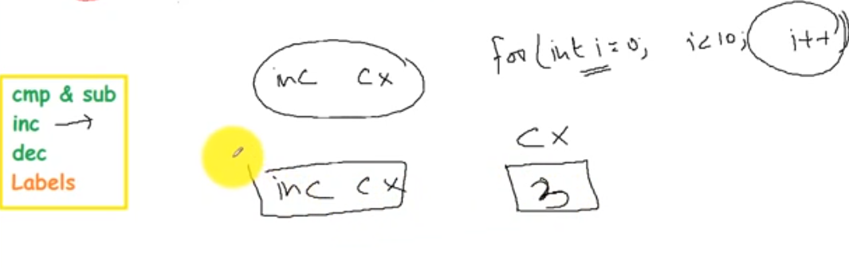

Slide 9
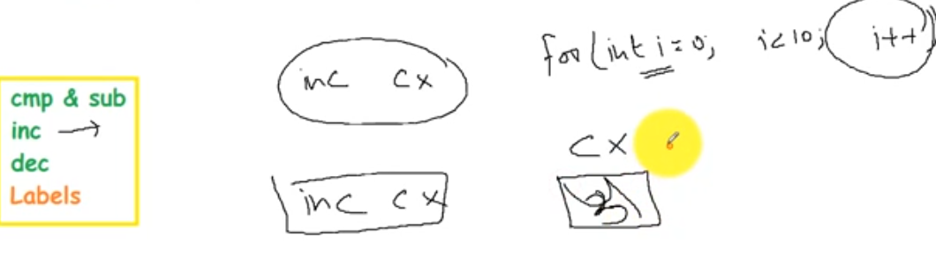

Slide 10
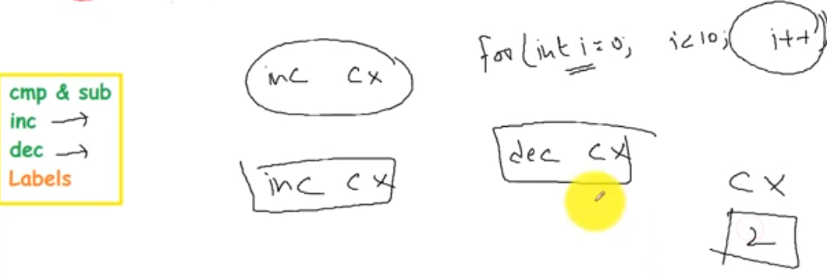

Slide 11
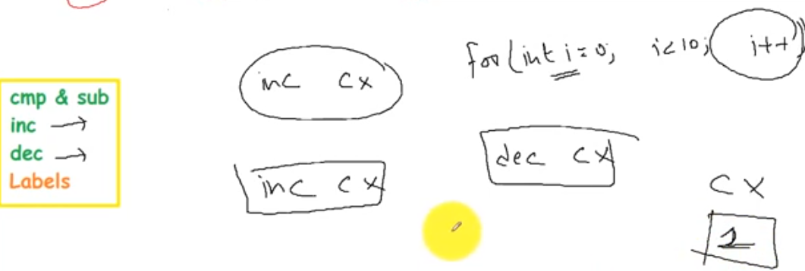

Slide 12
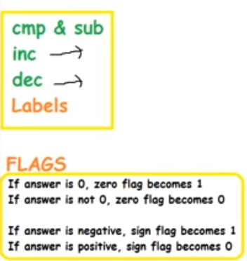

Slide 13
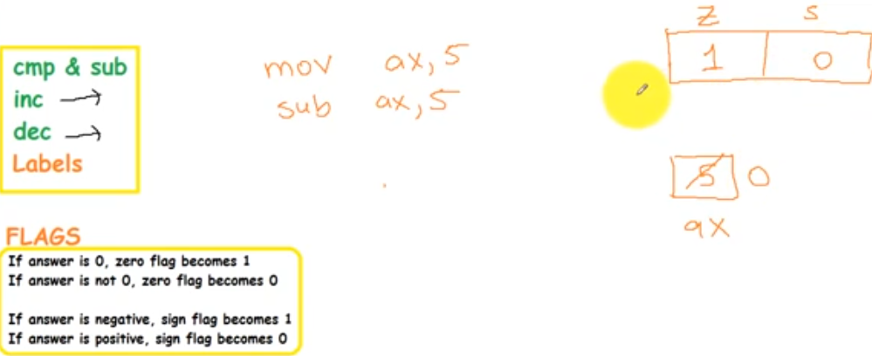

Slide 14
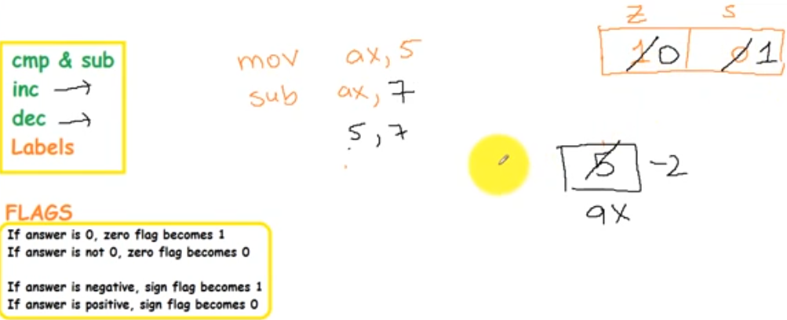

Slide 15
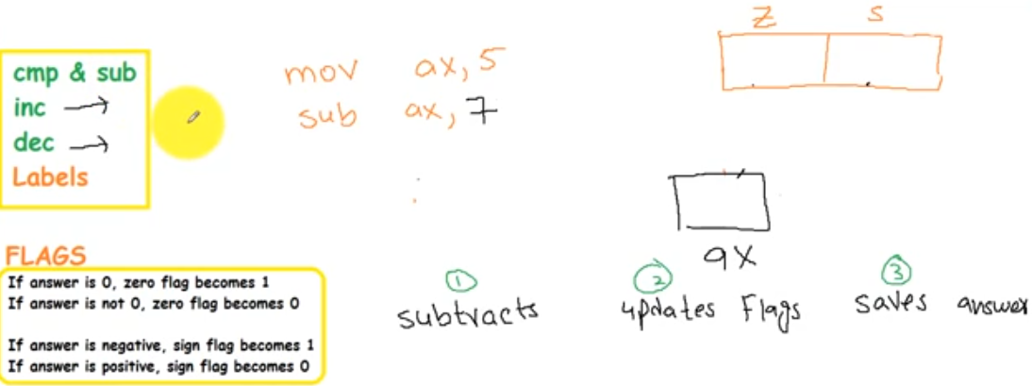
Difference b/w cmp and sub

Slide 16
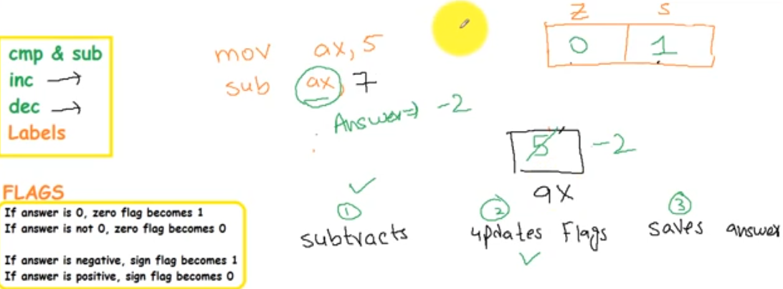
Difference b/w cmp and sub - sub

Slide 17
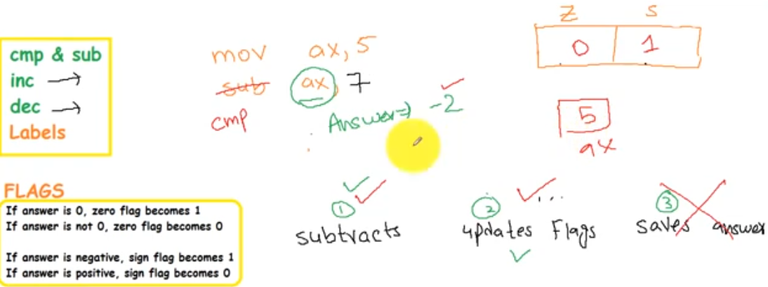
Difference b/w cmp and sub - cmp

Slide 18
CMP
Subtracts the source (src) from destination (dest)
Does not change contents of src or dest.
Affects AF,CF,OF,PF,SF and ZF.
The relation is of destination to source.
Notes:
CMP is the compare instruction and its subtracts the source from the destination and updates the flags accordingly without changing the source or the destination.

Slide 19
Conditional Jump
jnz
Jump if the zero flag is not set.
Zero flag is set if the last logical or mathematical instruction has produced a zero in its destination.

Slide 20
Conditional Jumps
jz ;jump if zero [ZF=1]
Jnz ;jump if not zero [ZF=0]
Example
cmp ax, bx
jz label1
This is to check that wether ax=bx and if both are equal than we will jump.
Notes:
The example above means that cmp ax,bx i.e. we subtract and if the result is 0 which means that both are equal than the instruction below is jump if zero i.e. jz

Slide 21
Conditional Jumps
je ;jump if equal [same as jz]
Jne ;jump if not equal [same as jnz]
Notes:
Jump if equal is also same in the meaning as jz and jne is the same as jnz.

Slide 22
Conditional Jumps
jc ;jump if carry [CF=1]
Jnc ;jump if not carry [CF=0]
Example
.add ax, bx
jc label1
.sub ax, bx
jnc label1
Notes:
Jump if carry is set if we have some kind of carry in our arithmetic instructions i.e. jc
Jump if not carry is true if the arithmetic instruction did not produce any carry.

Slide 23
Conditional Jumps
ja ;jump if above [ZF = 0 and CF=0]
jb ;jump if below [CF=1]
unsigned integers
jl ;jump if less [SF <> OF=0]
jg ;jump if greater [ZF = 0 and SF=OF]
signed integers
Notes:
The relationship is always from destination to source.
If the destination is above (greater) the source than the jump will be taken.
Similarly jb means that if the destination is below source so it is less than the source.
Both of these are associated with the unsigned integers.
-------------------------------------------------------
Jump if less means that the destination is less than or smaller than the source
-------------------------------------------------------
The comparison is a relationship from the destination to the source so here the relationship also means in the sense so if we are saying that jump is above so what is above what i.e. source is above the destination or the destination is above the source .
If the destination is above the sources than the ‘jump if above ‘ will be taken here above means greater and it means that the numbers that we are using for comparison are all un signed integers so above means that the destination number is greater than the source number.
-------------------------------------------------------
If x <> y Then can be read as
if x is less than y or x is greater than y then
The logical outcome being "If x is anything except equal to y"

Slide 24
Conditional Jumps
The relationship is always from destination to source.
If the destination is above (greater) the source than the jump will be taken.
Similarly jb means that if the destination is below source so it is less than the source.
Both of these are associated with the unsigned integers.
-------------------------------------------------------
Jump if less means that the destination is less than or smaller than the source
-------------------------------------------------------
The comparison is a relationship from the destination to the source so here the relationship also means in the sense so if we are saying that jump is above so what is above what i.e. source is above the destination or the destination is above the source .
If the destination is above the sources than the ‘jump if above ‘ will be taken here above means greater and it means that the numbers that we are using for comparison are all un signed integers so above means that the destination number is greater than the source number.
-------------------------------------------------------
If x <> y Then can be read as
if x is less than y or x is greater than y then
The logical outcome being "If x is anything except equal to y"

Slide 25
Conditional Jumps
Jae ;jump if above or equal
jbe ;jump if below or equal
jge ;jump if greater or equal
jle ;jump if less or equal
jno ;Jump if not overflow
jns ; Jump if not sign

Slide 26
Renamed Conditional Jumps
JNBE ⬄ JA
JNB ⬄ JAE
JNAE ⬄ JB
JNA ⬄ JBE
JZ ⬄ JE
JNLE ⬄ JG
JNL ⬄ JGE
JNGE ⬄ JL
JNG ⬄ JLE
JNZ ⬄ JNE
JPO ⬄ JNP
JPE ⬄ JP
e.g. the first one is jump if not below or equal also means that
the destination is greater so it is JA or jump if above.
Notes:
e.g. the first one is jump if not below or equal also means that the destination is greater so it is JA or jump if above.

Slide 27
Conditional Jumps
jcxz ;jump if the cx register is zero [cx=0]

